Slide 1
Welcome to our RSE Consultation Evening
In May 2019 Damian Hinds, the then Secretary of State for Education, was widely quoted in the media when he stated that:
“It is entirely right that schools should prepare children to thrive in our diverse society, a society that is based on tolerance and respect for others who are different….We brought our curriculum for relationships up to date precisely so that it more accurately reflects the world that children are growing up in now.”

Slide 2
Aims of this consultation:
give you an opportunity to understand the purpose and content of Relationships Education, and Sex Education (RSE)
Provide information about what is being taught when and how
Give you the chance to ask any questions and debunk some myths
Explore some of the resources that will be used in school
Have valuable conversations about your views and opinions so that we can ensure we develop a PSHE policy that is the right fit for our community and gives our children the very best opportunities to flourish.
We recognise parents and carers as the prime educators, with schools taking responsibility for complementing and reinforcing this role.

Slide 3
What has changed?
Relationship and Sex Education and Health Education
Although this has been taught in schools for a long time, the content of what was taught was not statutory.
The government have formalised which content needs to be taught at which age and incorporated it into the national curriculum to ensure that all children have equal access to important information that supports them in building positive relationships and understanding their own bodies.
Relationship and health education are now compulsory.

Slide 4
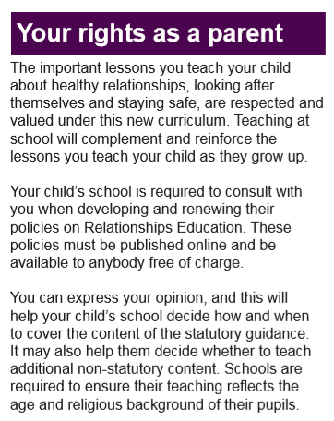
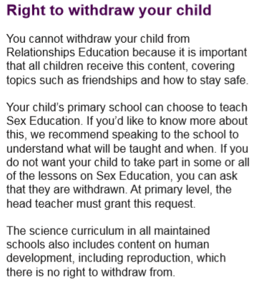

Slide 5
Why have things changed?
Research tells us:
1 in 4 girls start their period before learning about them at school. Some girls will start in year 3 / 4.
1 in 20 children are sexually abused and 1 in 3 of these not report this to an adult. Sexual abuse can happen to any child; the best way to safeguard children is to ensure that they receive information on naming parts of their body, knowing the difference between appropriate and inappropriate touch, and having the skills and confidence to find and talk to a trusted adult to report any abuse.
men and women who reported that lessons at school were their main source of information about sex were more likely to have started having sex at a later age than those for whom parents or other sources were their main source.
68% compared to 29% of young people who identify as LGBTQ+ have suicidal thoughts
Over half of 11-16 year olds have accessed porn online. Some as young as 6, many by accident. 3/100 primary aged children have viewed hardcore porn.
Ofsted review into sexual assult and harrassment shown we have been doing too little too late.
Notes:
https://ihpe.org.uk/1-in-4-girls-start-their-periods-before-learning-about-it-at-school/
https://learning.nspcc.org.uk/research-resources/statistics-briefings/child-sexual-abuse
https://www.gov.uk/government/publications/review-of-sexual-abuse-in-schools-and-colleges/review-of-sexual-abuse-in-schools-and-colleges
4. 4. https://assets.publishing.service.gov.uk/government/uploads/system/uploads/attachment_data/file/412427/LGB_Suicide_Prevention_Toolkit_FINAL.pdf
https://www.thetrevorproject.org/resources/article/facts-about-lgbtq-youth-suicide/ https://www.justlikeus.org/blog/2021/11/25/lgbt-young-people-twice-likely-suicide/
5. https://www.bbfc.co.uk/about-us/news/children-see-pornography-as-young-as-seven-new-report-finds https://www.thefreelibrary.com/PORN%3B+Should+kids+be+taught+about+it+in+schools+at+the+age+of+5%3F-a0330564641

Slide 6
Ofsted review into sexual assult and harrasment
Girls told us that sexual harassment and online sexual abuse, such as being sent unsolicited explicit sexual material and being pressured to send nude pictures (‘nudes’), are much more prevalent than adults realise.
Nearly 90% of girls, and nearly 50% of boys, said being sent explicit pictures or videos of things they did not want to see happens a lot or sometimes to them or their peers.
Children and young people told us that sexual harassment occurs so frequently that it has become ‘commonplace’.

Slide 7
Ofsted review into sexual assult and harrasment
92% of girls, and 74% of boys, said sexist name-calling happens a lot or sometimes to them or their peers. The frequency of these harmful sexual behaviours means that some children and young people consider them normal.
Children and young people were rarely positive about the RSHE they had received. They felt that it was too little, too late and that the curriculum was not equipping them with the information and advice they needed to navigate the reality of their lives. Because of these gaps, they told us they turned to social media or their peers to educate each other, which understandably made some feel resentful. As one girl put it, ‘It shouldn’t be our responsibility to educate boys’.
https://www.gov.uk/government/publications/review-of-sexual-abuse-in-schools-and-colleges/review-of-sexual-abuse-in-schools-and-colleges

Slide 8
All schools should teach Personal, social, health and economic education (PSHE), drawing on good practice, and this expectation is outlined in the introduction to the proposed new national curriculum.
Schools should seek to use PSHE education to build, where appropriate, on the statutory content already outlined in the national curriculum, the basic school curriculum and in statutory guidance on: drug education, financial education, sex and relationship education (SRE) and the importance of physical activity and diet for a healthy lifestyle.
How do we address these issues?
National curriculum:

Slide 9
By the end of primary:
Families and people who care about me
Caring friendships
Respectful relationships
Online relationships
Being safe
What does relationship education cover?

Slide 10
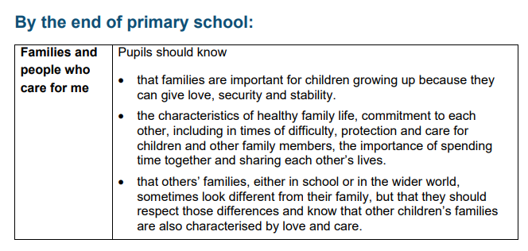
Relationships education

Slide 11
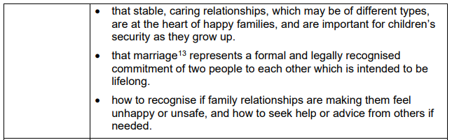
Teaching about families requires sensitive and well-judged teaching based on knowledge of pupils and their circumstances. Families of many forms provide a nurturing environment for children. (Families can include for example, single parent families, LGBT parents, families headed by grandparents, adoptive parents, foster parents/carers amongst other structures.) Care needs to be taken to ensure that there is no stigmatisation of children based on their home circumstances and needs, to reflect sensitively that some children may have a different structure of support around them; e.g. looked after children or young carers.

Slide 12
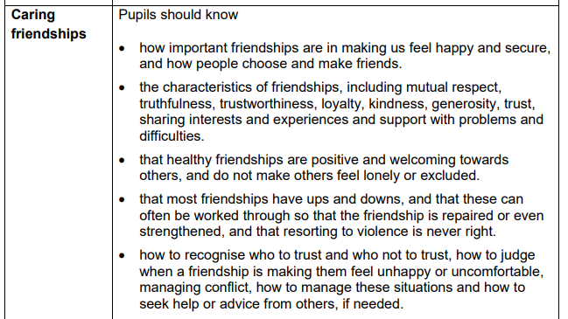

Slide 13
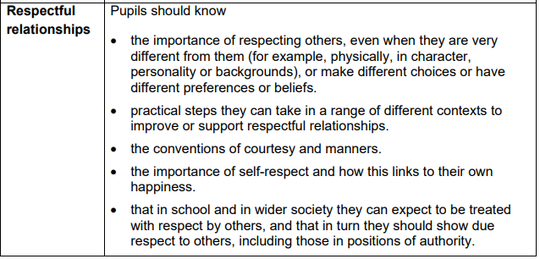

Slide 14
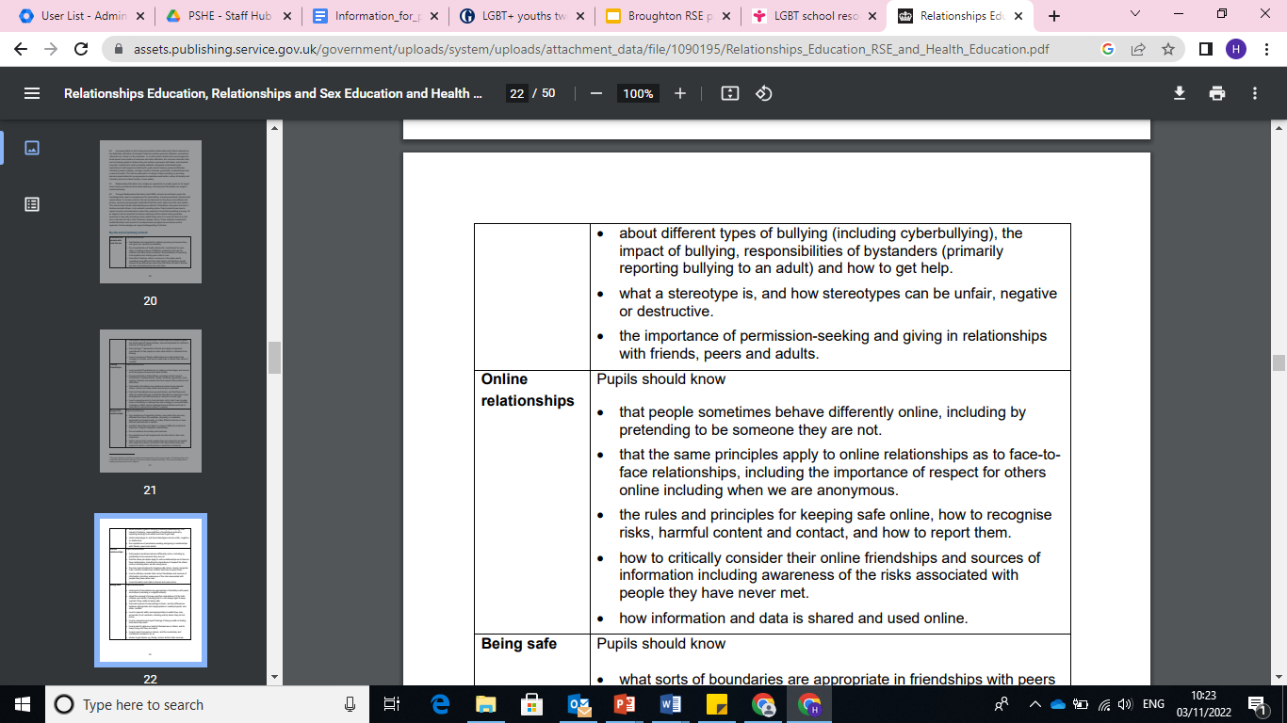

Slide 16
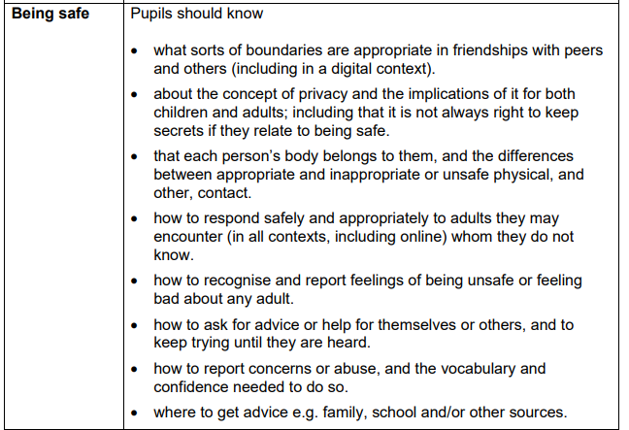

Slide 17
The content set out in the guidance covers everything that primary schools should teach about relationships and health, including puberty.
The national curriculum for science also includes subject content in related areas, such as the main external body parts, the human body as it grows from birth to old age (including puberty) and reproduction in some plants and animals.
The Department continues to recommend that all primary schools should have a sex education programme tailored to the age and the physical and emotional maturity of the pupils. It should ensure that both boys and girls are prepared for the changes that adolescence brings and – drawing on knowledge of the human life cycle set out in the national curriculum for science - how a baby is conceived and born.
Puberty including menstruation should be covered in Health Education and should, as far as possible, be addressed before onset. This should ensure male and female pupils are prepared for changes they and their peers will experience.
https://assets.publishing.service.gov.uk/government/uploads/system/uploads/attachment_data/file/1090195/Relationships_Education_RSE_and_Health_Education.pdf

Slide 18
Preparing children for the physical, mental and emotional changes of puberty
What does this mean?

Slide 19
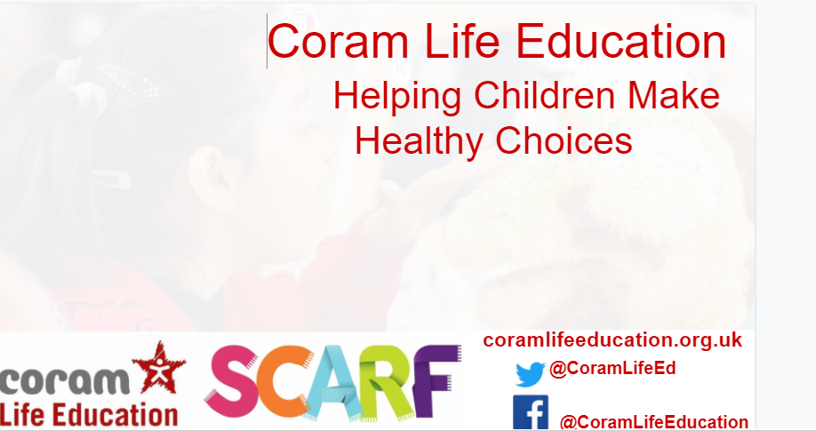
Our Program

Slide 20
Why this program?
SCARF provides the framework for a whole- school approach to improving children’s wellbeing and attainment, based on the five SCARF values of safety (S),caring (C),achievement (A), resilience (R) and friendship (F).
The Relationships and Sex Education resources, based on current expertise and research, help children and young people to be safe, healthy and happy as they grow, and in their future lives.
The structure of the program will ensure our staff can deliver a cohesive, age appropriate program and give support in ensuring they handle sensitive issues successfully.
It helps ensure our PSHE curriculm meets our current SMSC (spiritual, moral, social and cultural) development, safeguarding, and emotional wellbeing requirements, as well as ensuring that they meet the requirements of the DfE Primary Relationships, Sex and Health Education Curriculum, and National Curriculum Science from 2020.

Slide 21
SCARF:
We define menstruation, wet dreams and masturbation (all parts of puberty) as falling within Health Education (under the Changing Adolescent Body section) not Sex Education, and therefore part of the statutory requirements. Naming parts of the body, including genitalia, comes under statutory Relationships Education, within the Being Safe unit; requirement number 7: 'How to report concerns or abuse, and the vocabulary and confidence to do so', It also comes under National Curriculum Science where children are required to be able to name the external body parts and so is again statutory.
However, if you feel that your pupils are not ready for this information in the year group it has been suggested within the SCARF curriculum, then you have the flexibility to deliver the lesson in a later year, when you feel it would best meet your pupils' needs.
Preparing children for the physical, mental and emotional changes of puberty

Slide 23
Structure of learning
The program is split into 6 key areas of learning. One for each half term.
 | Autumn 1 | Autumn 2 | Spring 1 | Spring 2 | Summer 1 | Summer 2
Year R | Me and my Relationships | Valuing difference | Keeping Safe | Rights and Respect | Being my best | Growing and Changing
Year 1 | Me and my Relationships | Valuing difference | Keeping Safe | Rights and Respect | Being my best | Growing and Changing
Cycle A | Me and my Relationships | Me and my Relationships | Valuing difference | Valuing difference | Keeping Safe | Growing and Changing
Cycle B | Being my best | Being my best | Rights and Respect | Rights and Respect | Keeping Safe | Growing and Changing
Year R and year 1 will have targeted PSHE sessions based on their year group. Although some lessons, where appropriate, can be chosen to be taught together. Willow and Oak will have their lessons as a whole class, except for the growing and changing unit in summer 2 which will be taught separately.

Slide 24
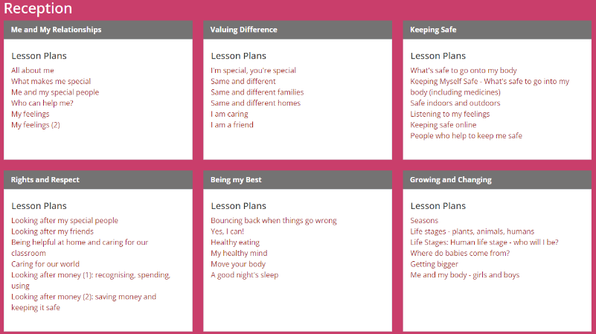

Slide 25
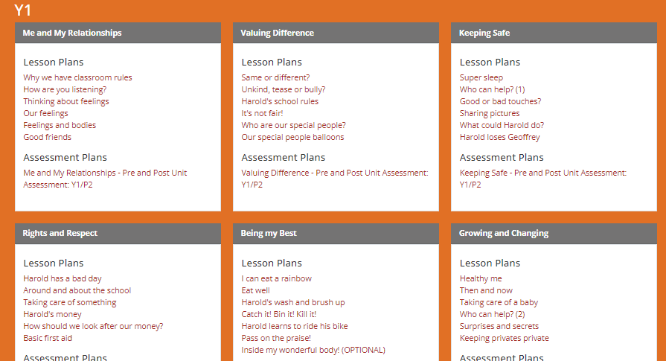

Slide 26
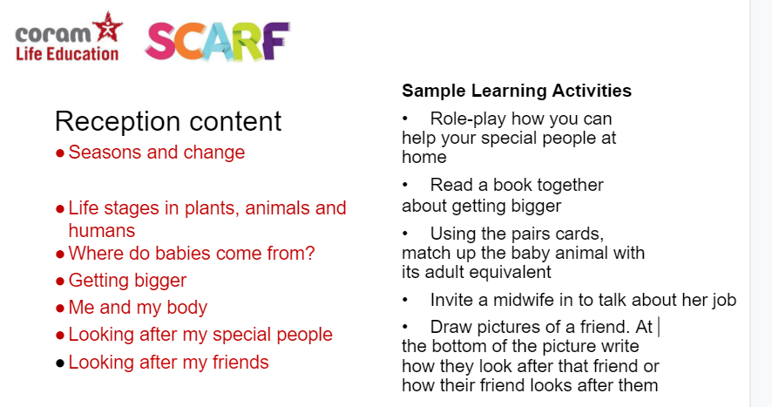

Slide 27
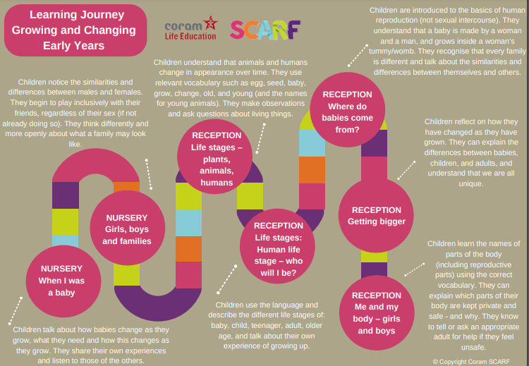

Slide 28
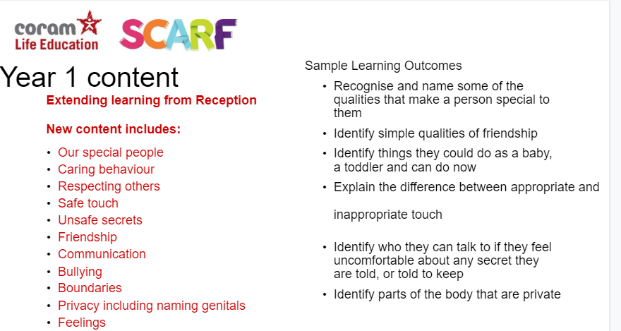

Slide 29
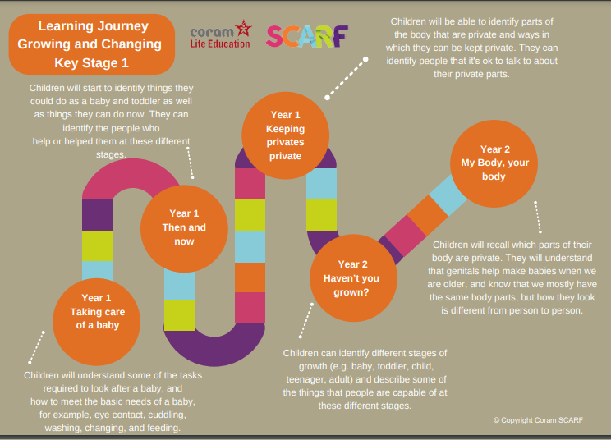

Slide 30
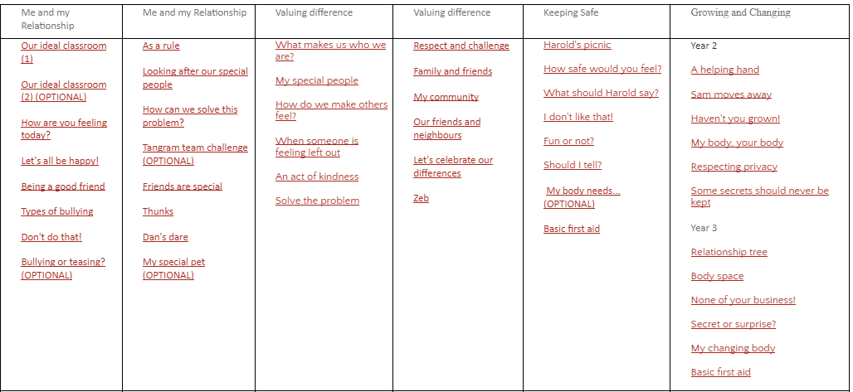
Year 2 / 3 Cycle A

Slide 31
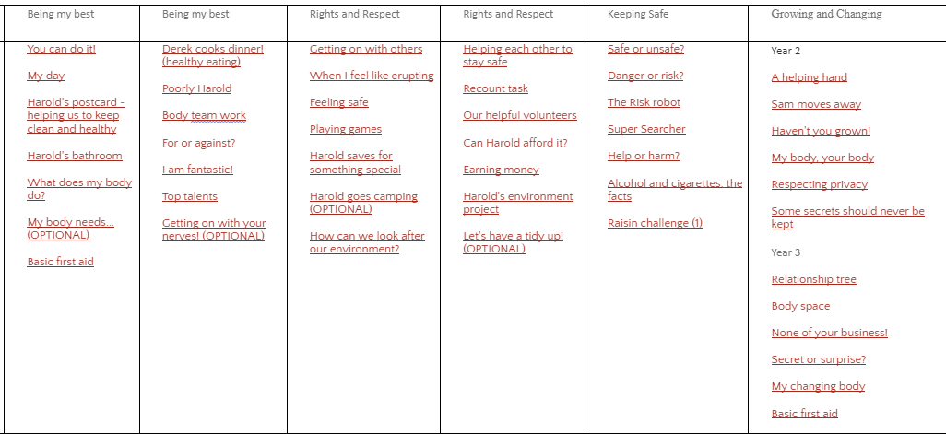
Year 2 / 3 Cycle B

Slide 32
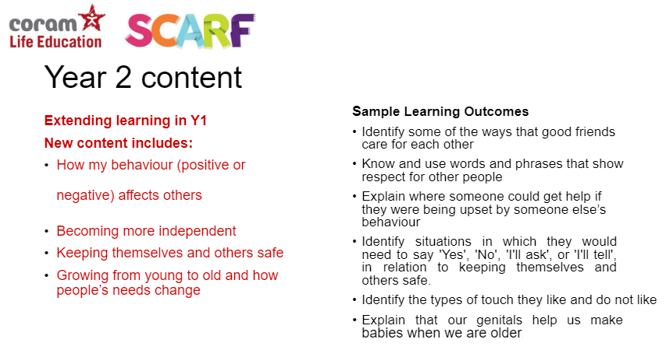

Slide 33
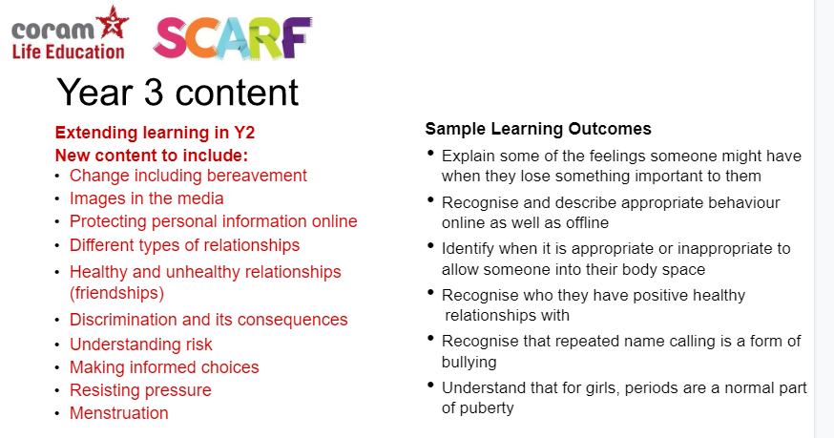
Notes:
Periods and wet dreams

Slide 34
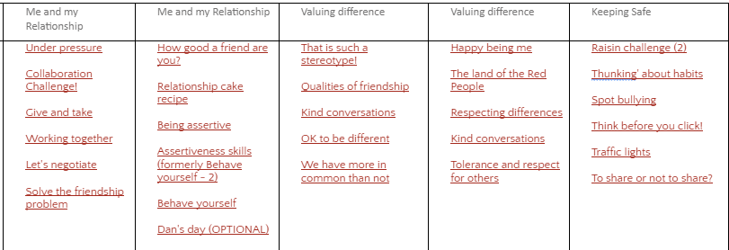
Year 4/5/6 Cycle A
Growing and changing
Year 5
Spot bullying
Play, like, share
Decision dilemmas
Ella's diary dilemma
Vaping: healthy or unhealthy?
Would you risk it?
'Thunking' about habits (OPTIONAL)
Drugs: true or false? (OPTIONAL)
Smoking: what is normal? (OPTIONAL)
Year 4
Moving house
My feelings are all over the place!
All change!
Preparing for changes at puberty (formerly Period positive/preparing for periods)
Secret or surprise?
Together
Year 6
Think before you click!
It's a puzzle (OPTIONAL)
To share or not to share?
Rat Park
What sort of drug is...?
Drugs: it's the law!
Alcohol: what is normal?

Slide 35
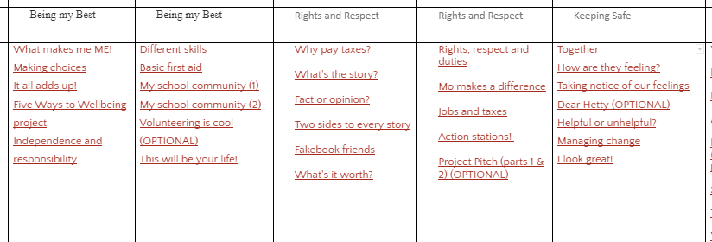
Year 4/5/6 Cycle B
Growing and changing
Year 5
Spot bullying
Play, like, share
Decision dilemmas
Ella's diary dilemma
Vaping: healthy or unhealthy?
Would you risk it?
'Thunking' about habits (OPTIONAL)
Drugs: true or false? (OPTIONAL)
Smoking: what is normal? (OPTIONAL)
Year 4
Moving house
My feelings are all over the place!
All change!
Preparing for changes at puberty (formerly Period positive/preparing for periods)
Secret or surprise?
Together
Year 6
Think before you click!
It's a puzzle (OPTIONAL)
To share or not to share?
Rat Park
What sort of drug is...?
Drugs: it's the law!
Alcohol: what is normal?

Slide 36
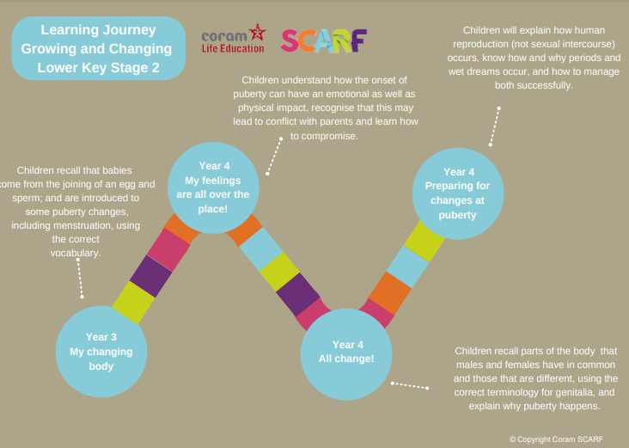

Slide 37
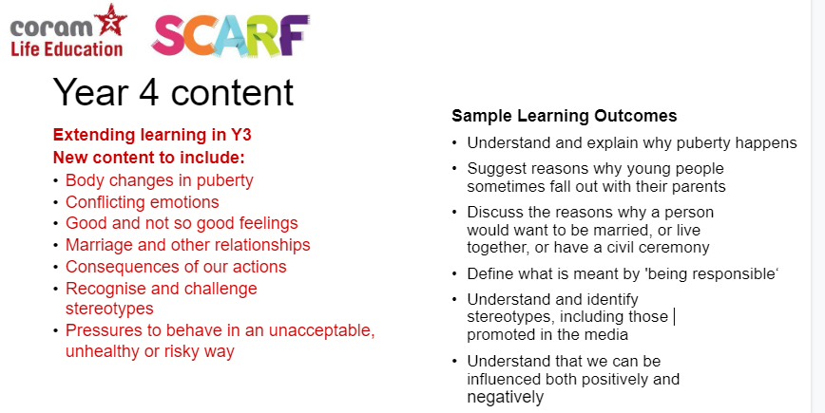
Guidance specifies that this is all key changes, including emotional physical and behavioural. For year 4 there is mention of masturbation in one of the lessons.

Slide 38
Links to videos recommended for use in a year 4 lesson
https://amaze.org/video/top-signs-boys-are-in-puberty/ - Following discussions at RSE initial consultation we are exploring different resources for this lesson so that the topic of masturbation isn’t raised until later. This is the only reference to masturbation within the year 4 curriculum.
https://amaze.org/video/all-about-getting-your-period/
https://amaze.org/video/top-signs-girls-are-in-puberty/

Slide 39
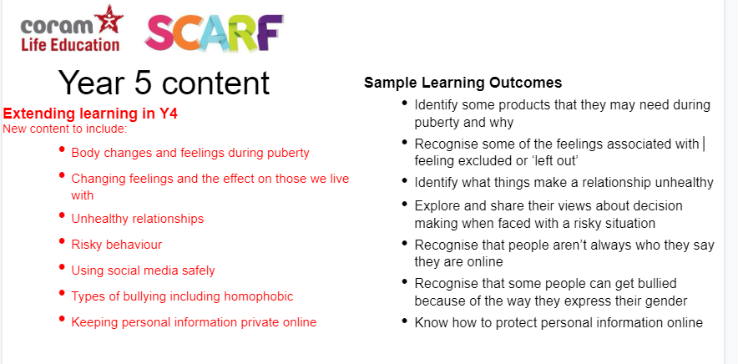
https://www.coramlifeeducation.org.uk/scarf/iwb/labelling-body-parts
Notes:
Focus on taking care of your body during/after puberty - looking at mensuration products in more detail, deodorant etc.

Slide 40
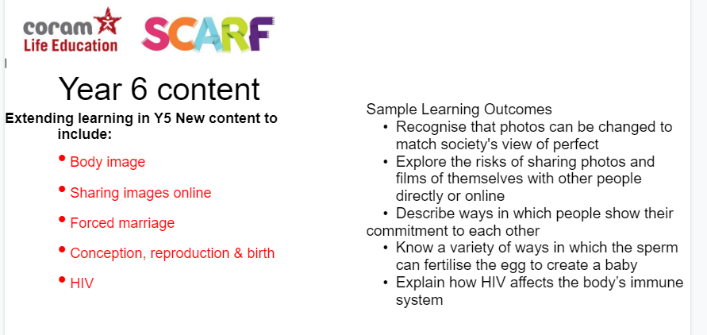
The non statutory lesson which covers sex education is clearly signposted for staff. We are currently figuring out the best way to share the video clip used with parents as it is subject to copyright.

Slide 41
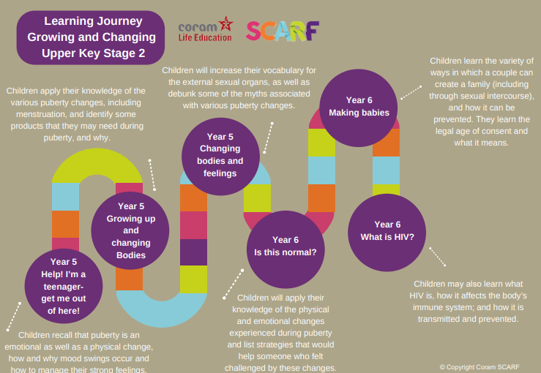

Slide 42
Language
Modelling a consistent approach to using correct terms in relation to our bodies, including genitalia, is a really helpful starting point. It shows that both female and male bodies can be discussed with the same confidence and accuracy.
Using correct terms school-wide contributes to safeguarding, as every child will be understood if they need to explain something about their bodies. It is essential that children know about bodily privacy and basic rules about consent.
To know “that their bodies are their own” is mandatory content in primary relationships education, as is learning how to get help in the case of abuse.
Double standards to do with gender are often reflected in language around what is considered acceptable or unacceptable behaviour. Children are alert to what is fair or unfair and can be supported to notice and challenge inequalities by reversing the gender roles in a fictional situation and asking: “Would it have been the same if he was a girl/she was a boy?”

Slide 43
Vocabulary Choices
We introduce body parts at the stage appropriate for the learning that is taking place. We will always use and encourage the children to use the scientific name for body parts to avoid confusion. In later years (¾ and up) children will be given the opportunity to discuss vocabulary they have heard for the body parts so that we can ensure they understand what slang they might be hearing means.
Growing and changing R
Seasons | Life stages | Life stages: who will I be? | Where do babies come from? | Getting bigger | Me and my body - girls and boys
Seasons spring summer autumn winter cycle | Growing life cycles | Baby child teenager adult old age | Family baby love care | Baby child teenager adult grow | private parts penis vulva

